Slide 1

Software Engineering Project
Ain Shams Hospital Management System

Slide 2
Our project is a hospital management system.
Patients, doctors, specialists, staff members and the manager can use this system easily.
In this presentation, we will present different use cases, their description and their simulation.

Slide 3
External Donations
Donor enters personal information.
Enters the day of donation.
Sends request.

Slide 4
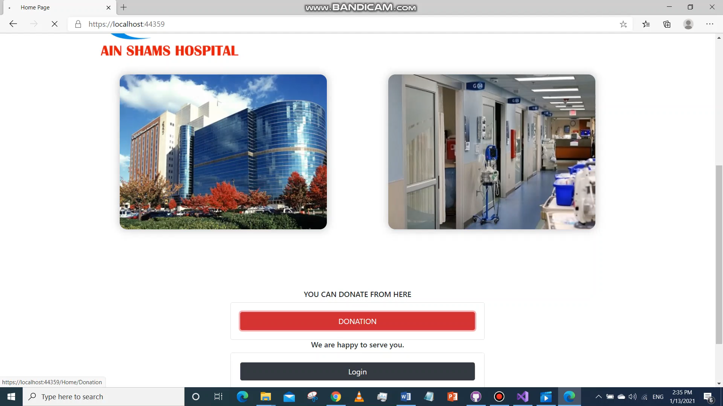

Slide 5
Patient

Slide 6
1) Sign Up and Login
The patient enters the activation code (0000) to open the sign up page of patient.
Enters personal information and signup.
Logs in with email and password to open the patient home page.

Slide 7
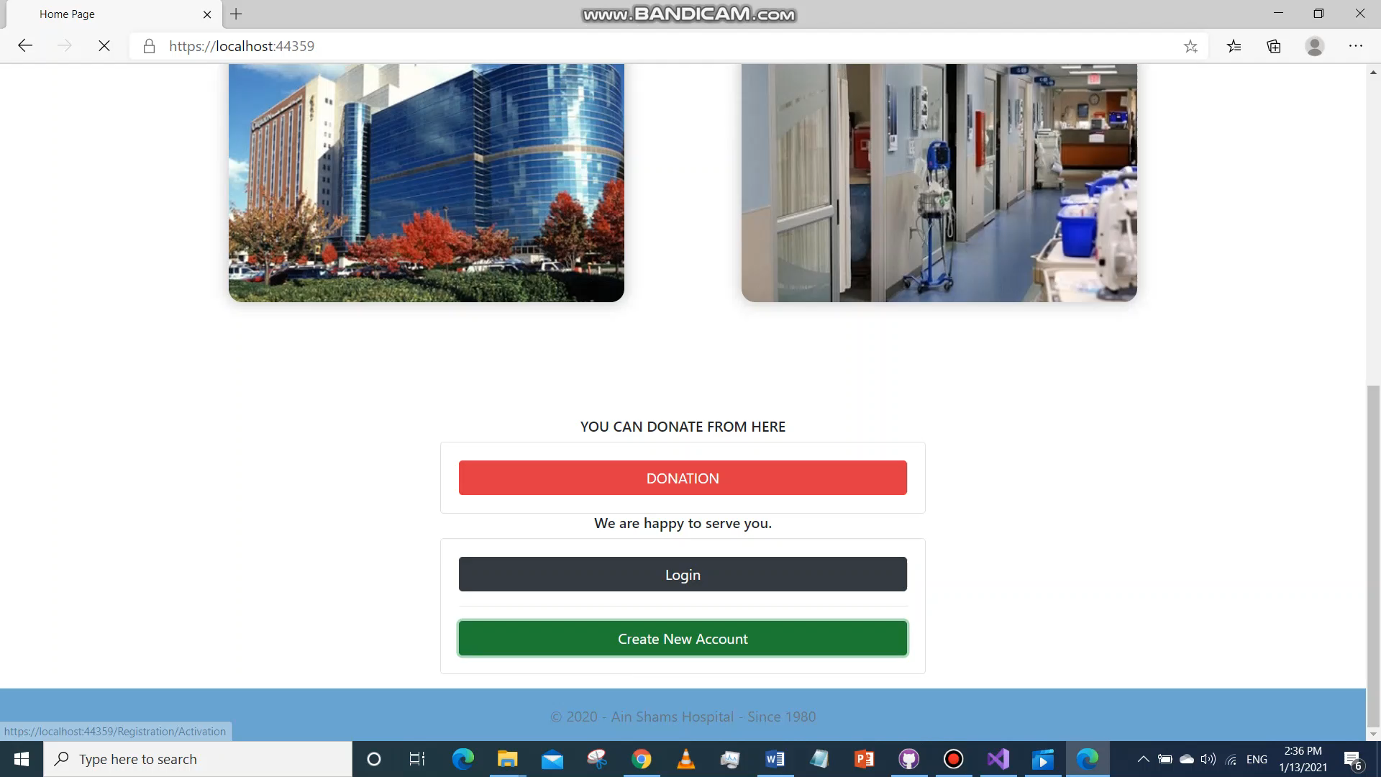

Slide 8
2) Add an Appointment
Patient can view different appointments for different doctors.
Chooses an appointment.
Pays fees for the appointment offline or online.

Slide 9
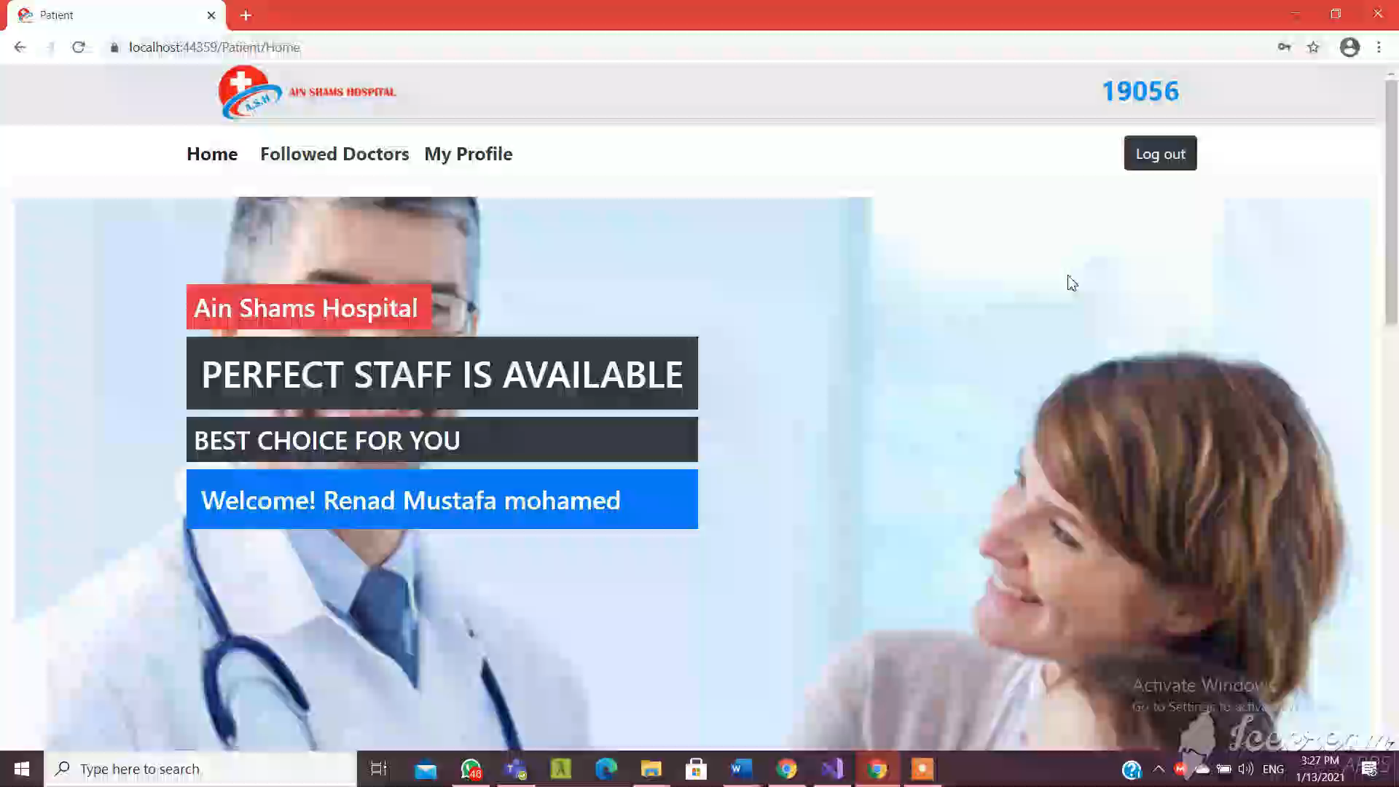

Slide 10
3) Get Services/ Surgery/ Lab
Patient views different services and laboratories.
Patient chooses a service and lab.
Pays fees for the laboratories /surgery offline or online.
Views his profile and edit it.
Views the followed doctor list and their schedules.

Slide 11
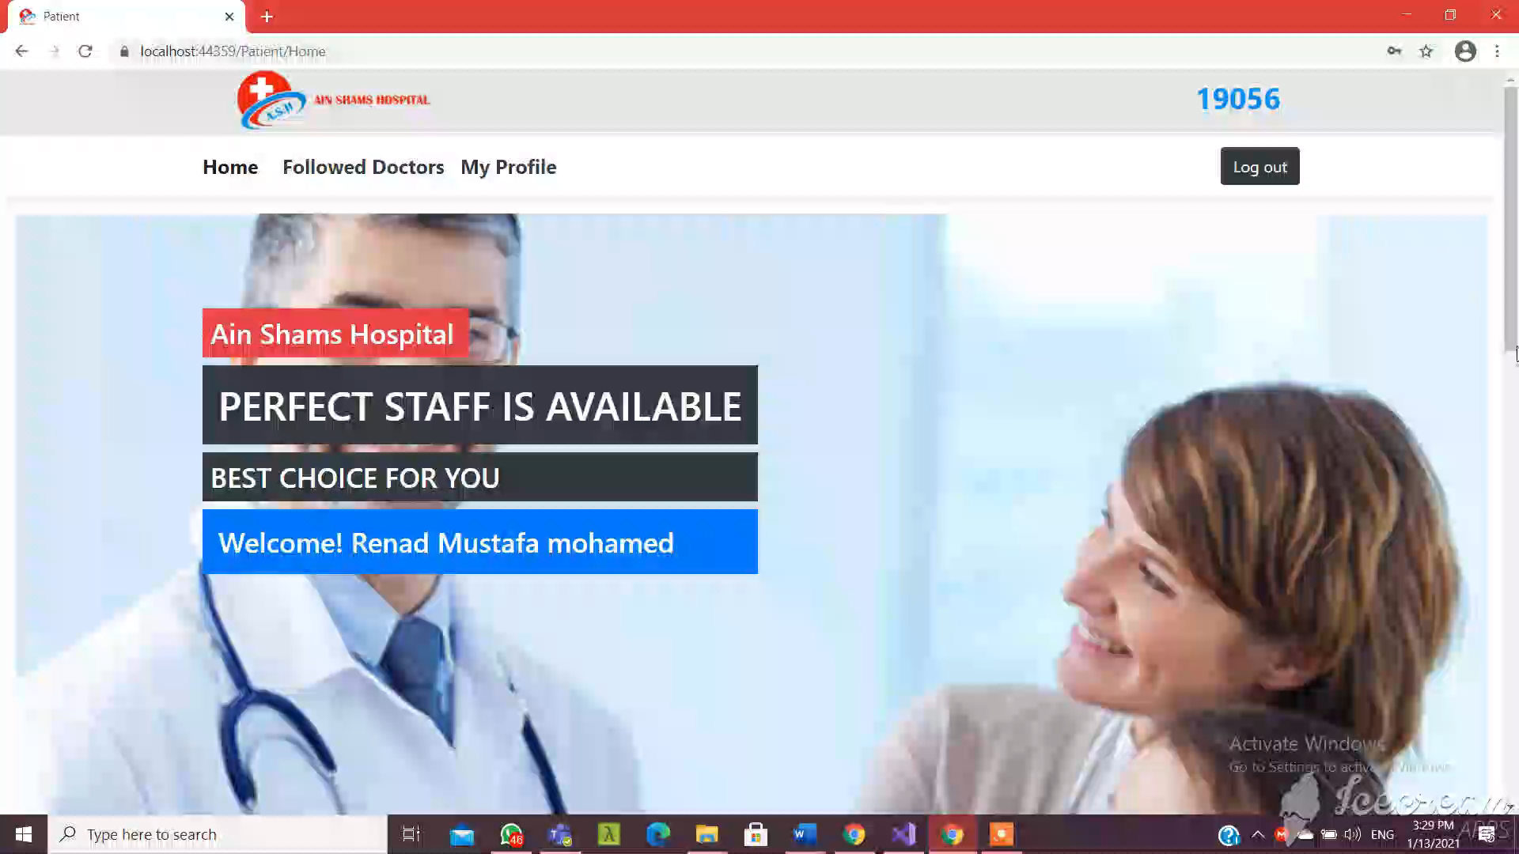

Slide 12
Doctor

Slide 13
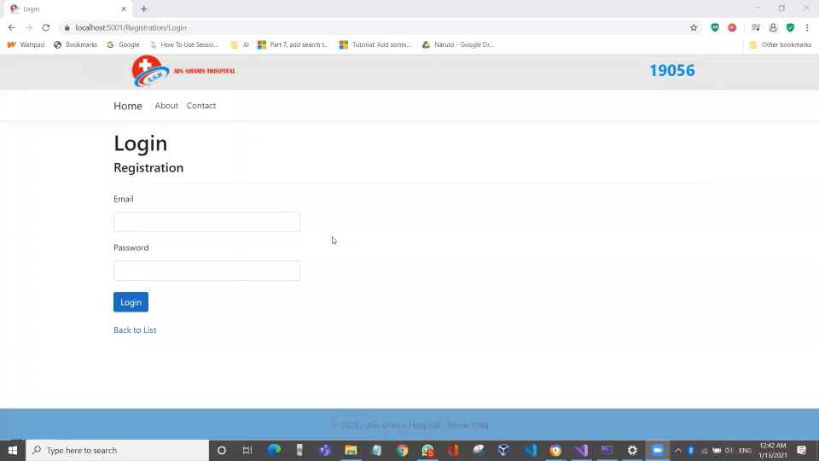
1) Login / View Schedules

Slide 14
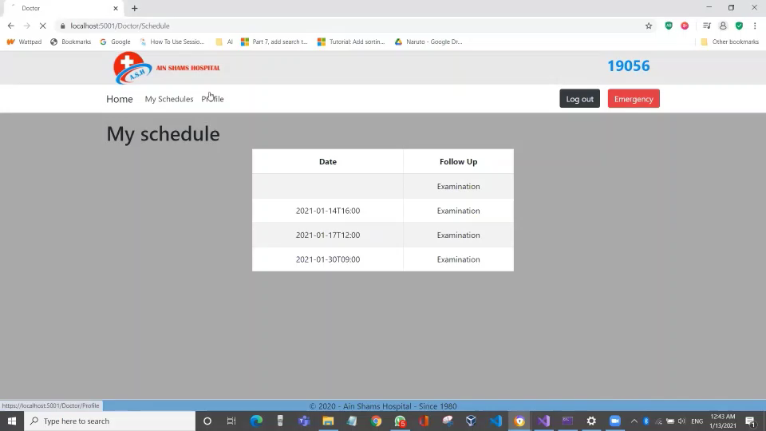
2) View Profile / Edit Profile

Slide 15
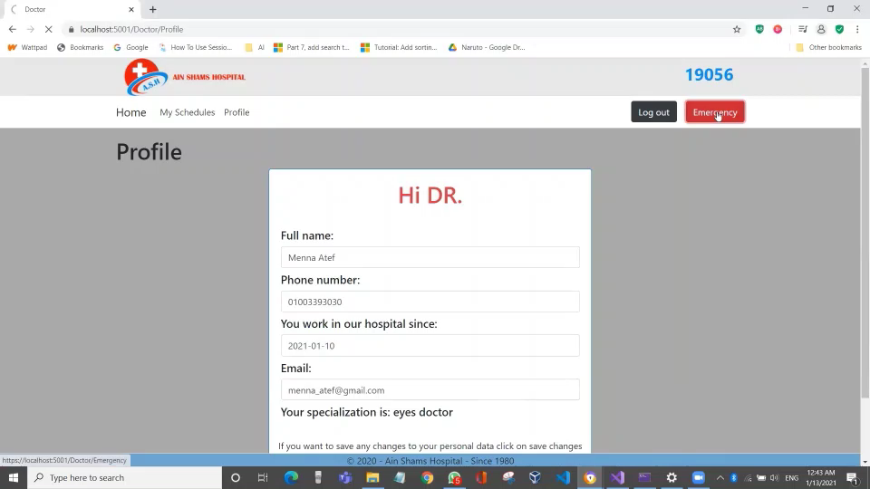
3) View Emergency Section
In emergency section, doctor can view the blood bank and emergency beds,

Slide 16
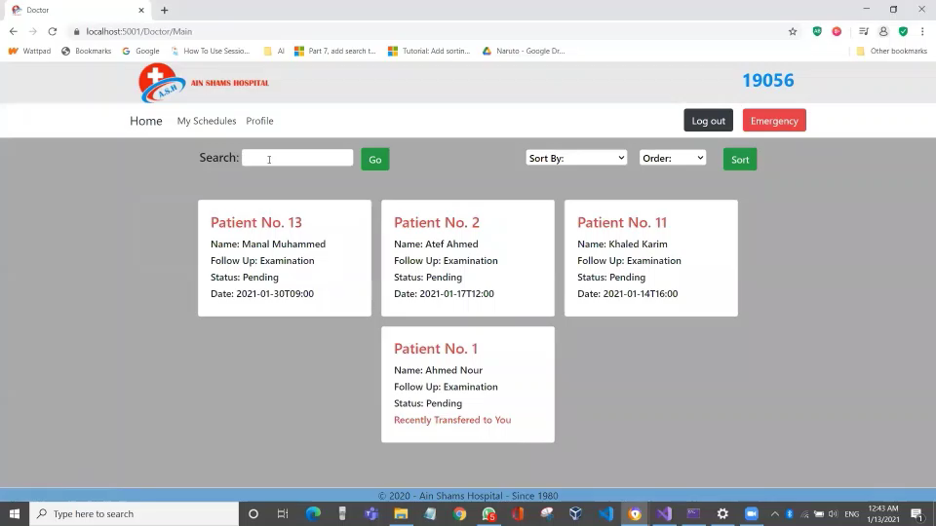
4) Search For Patient

Slide 17
5) View Patient’s Personal Data
Doctor can view patient’s personal and medical data.
Contact the patient.
Update medical data.

Slide 18
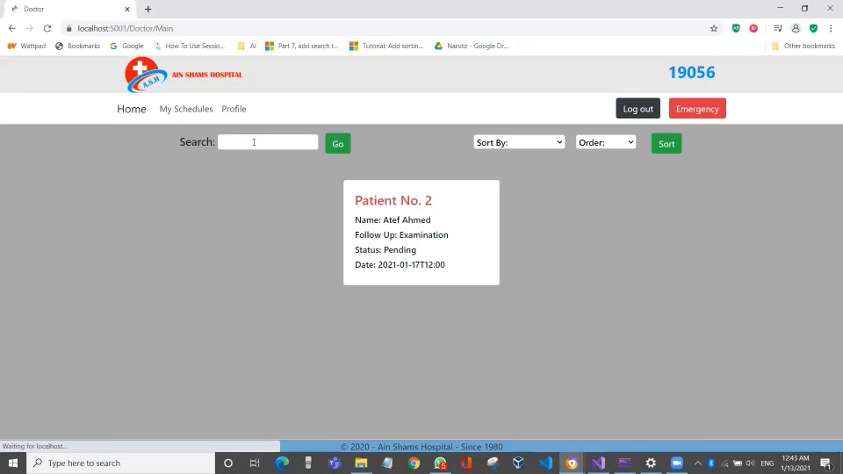

Slide 19
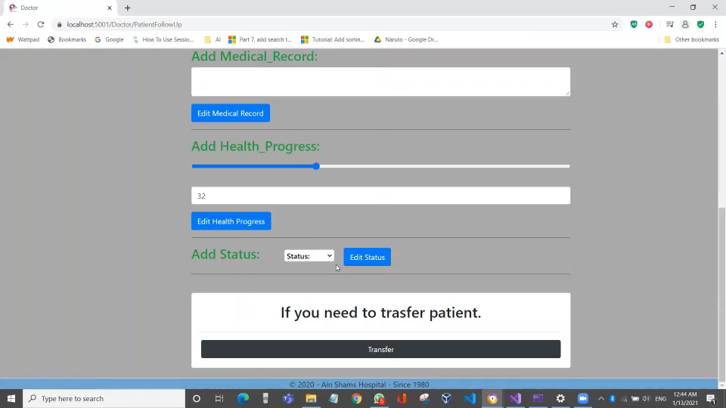
6) Transfer Patient to Another Hospital

Slide 20
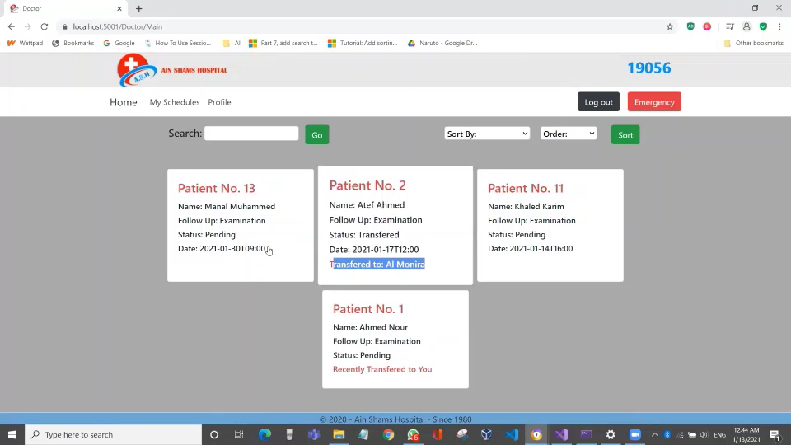
7) Transfer Patient to Another Doctor
After transferring patient to another doctor, log in to the other’s doctor account to view the transferred patient.

Slide 21
Blood Bank Specialist

Slide 22
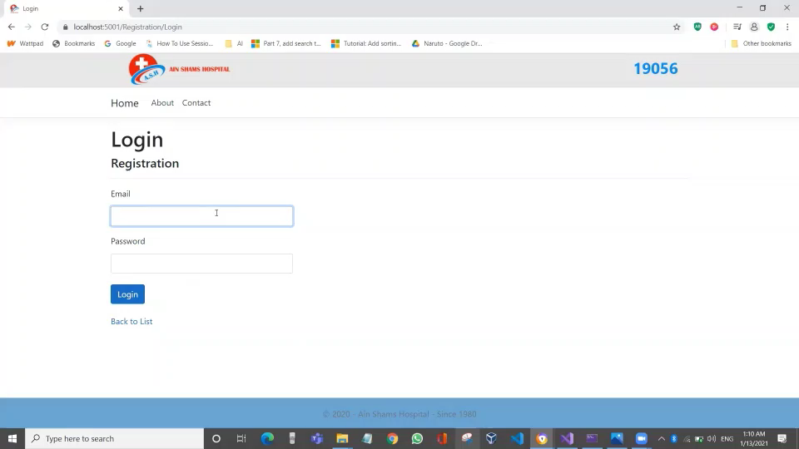
1) Login / View Blood Units
Blood bank specialist can view different types and amounts of blood units

Slide 23
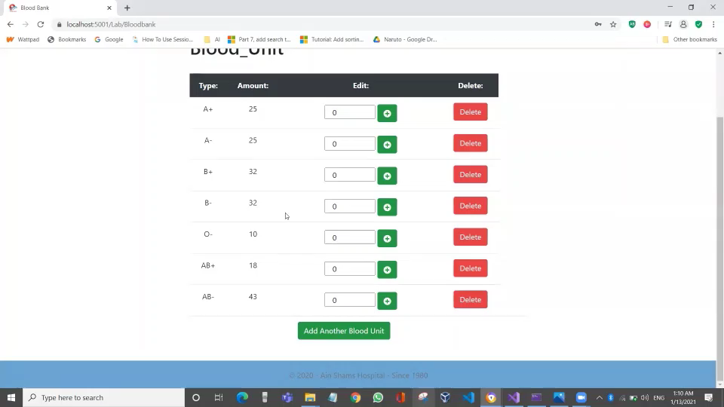
2) Edit Amount of Blood Unit
Blood bank specialist can add to or subtract from the amount of any blood unit.

Slide 24
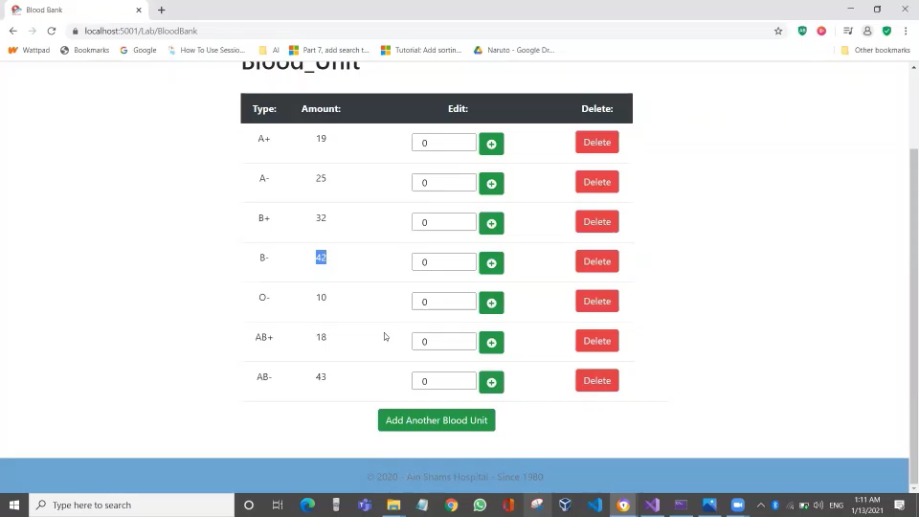
3) Add New Blood Unit

Slide 25
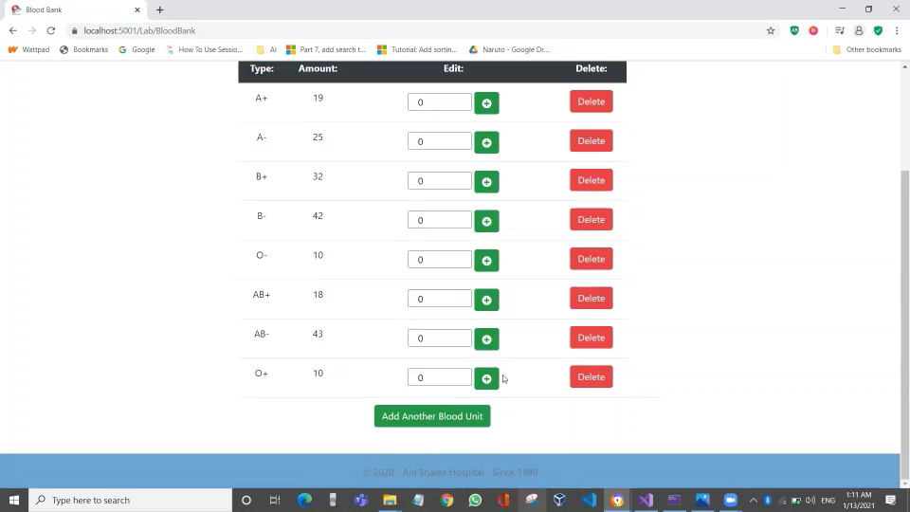
4) Delete a Blood Unit

Slide 26
Lab Specialist

Slide 27
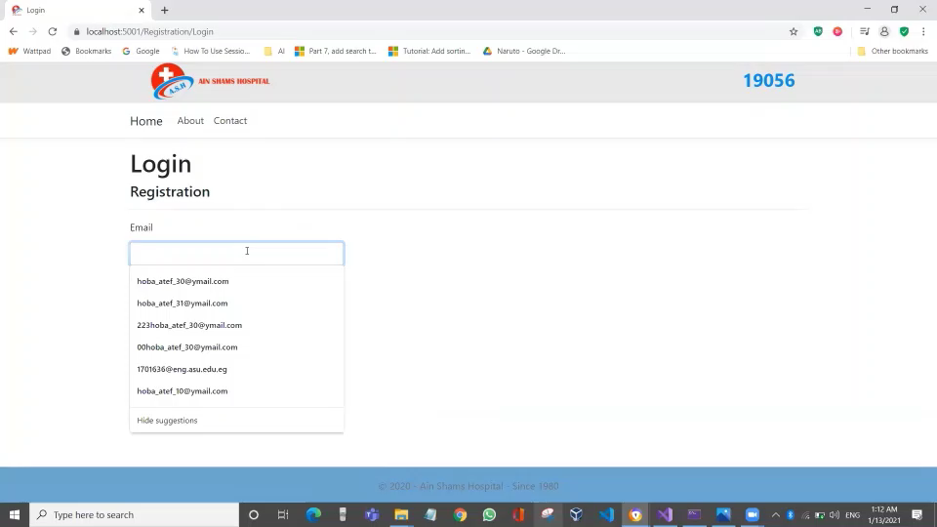
1) Login / Sort Lab Requests
Lab specialists can login and sort lab requests by any order. Here we sort them by ascending date.

Slide 28
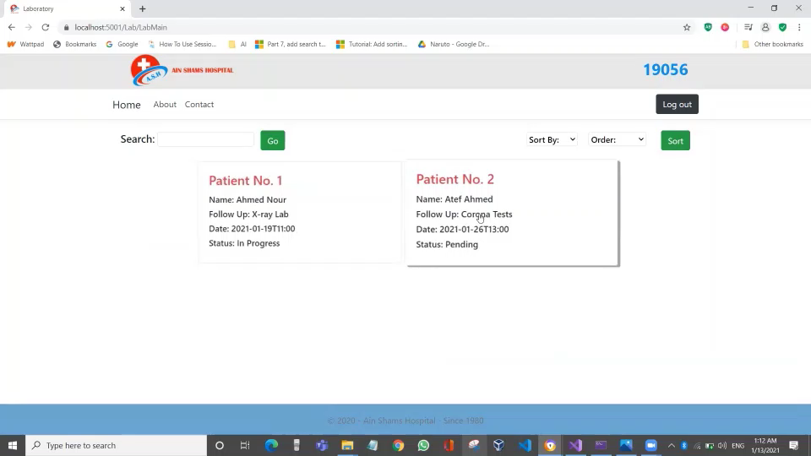
2) View Lab Requests
Lab specialist views a lab request and edit the status of the request.

Slide 29
Radiology Lab Specialist

Slide 30
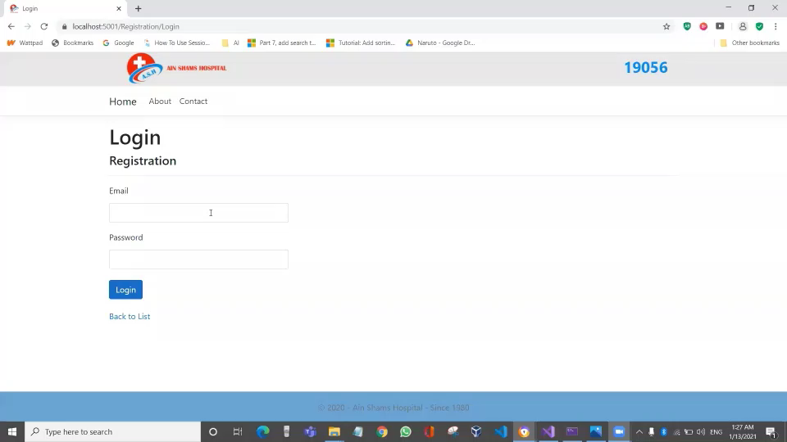
1) Login / Sort Lab Requests
Lab specialists can login and sort lab requests by any order. Here we sort them by descending status.

Slide 31
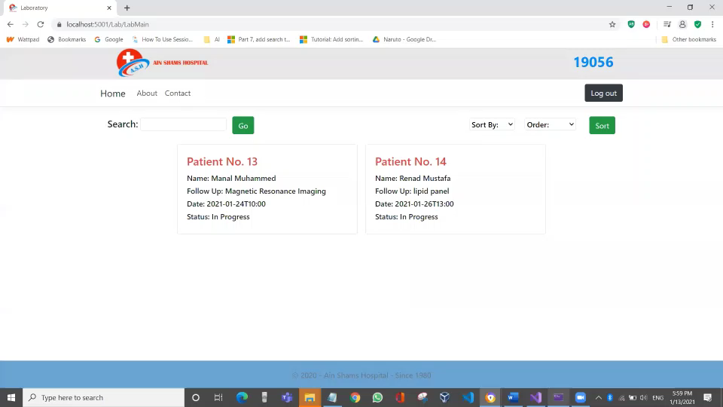
And here, we sort them by ascending follow up.

Slide 32
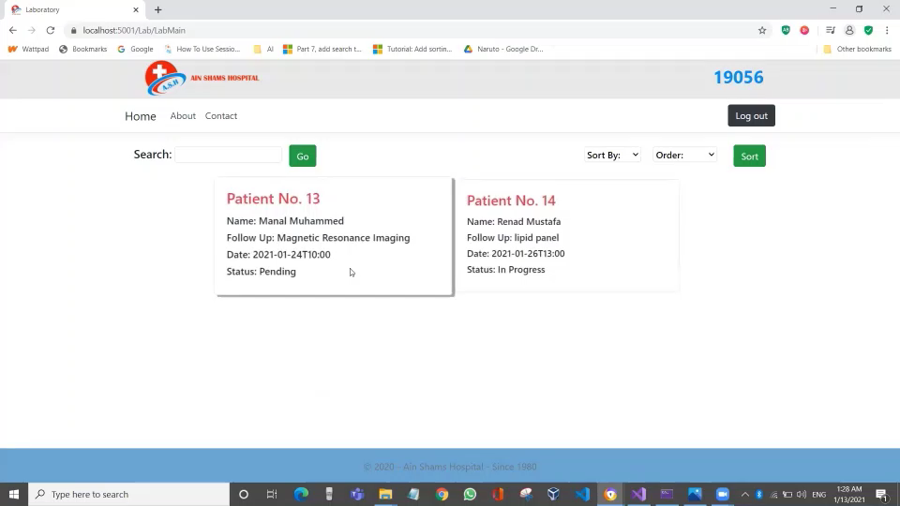
2) View Lab Requests
Radiology lab specialist views a lab request and edit the status of the request.

Slide 33
Front Desk

Slide 34
1) Sign Up
The front desk member enters the special activation code to open the sign up page of staff.
Enters personal information and signup to open the front desk home page.

Slide 35
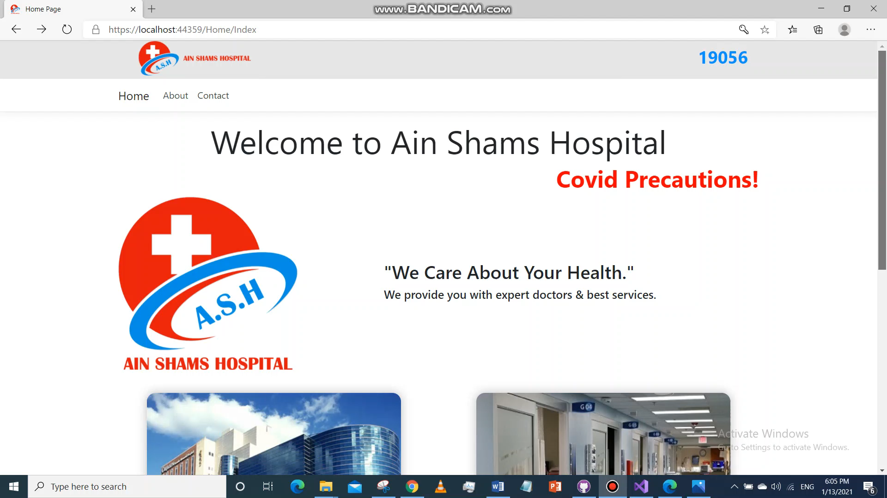

Slide 36
2) Reserve Surgery Room and Allocate Room
Front desk member enters time period he wants to reserve for a surgery room.
Enters time period he wants to reserve for a normal room and view available rooms.
Enters patient’s and doctor’s names and reserve the surgery and normal rooms.
View rooms information and the reservations are there.

Slide 37
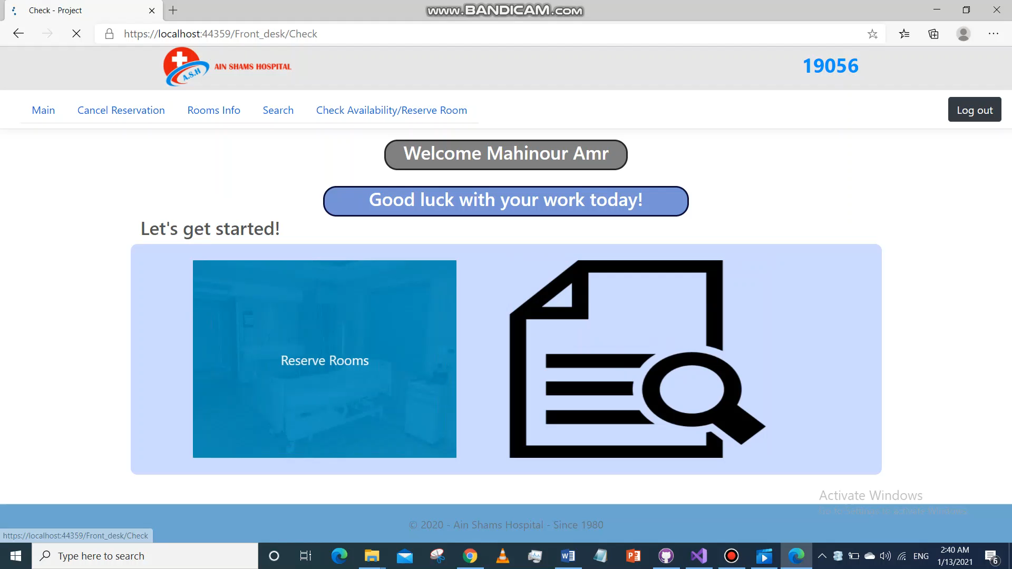

Slide 38
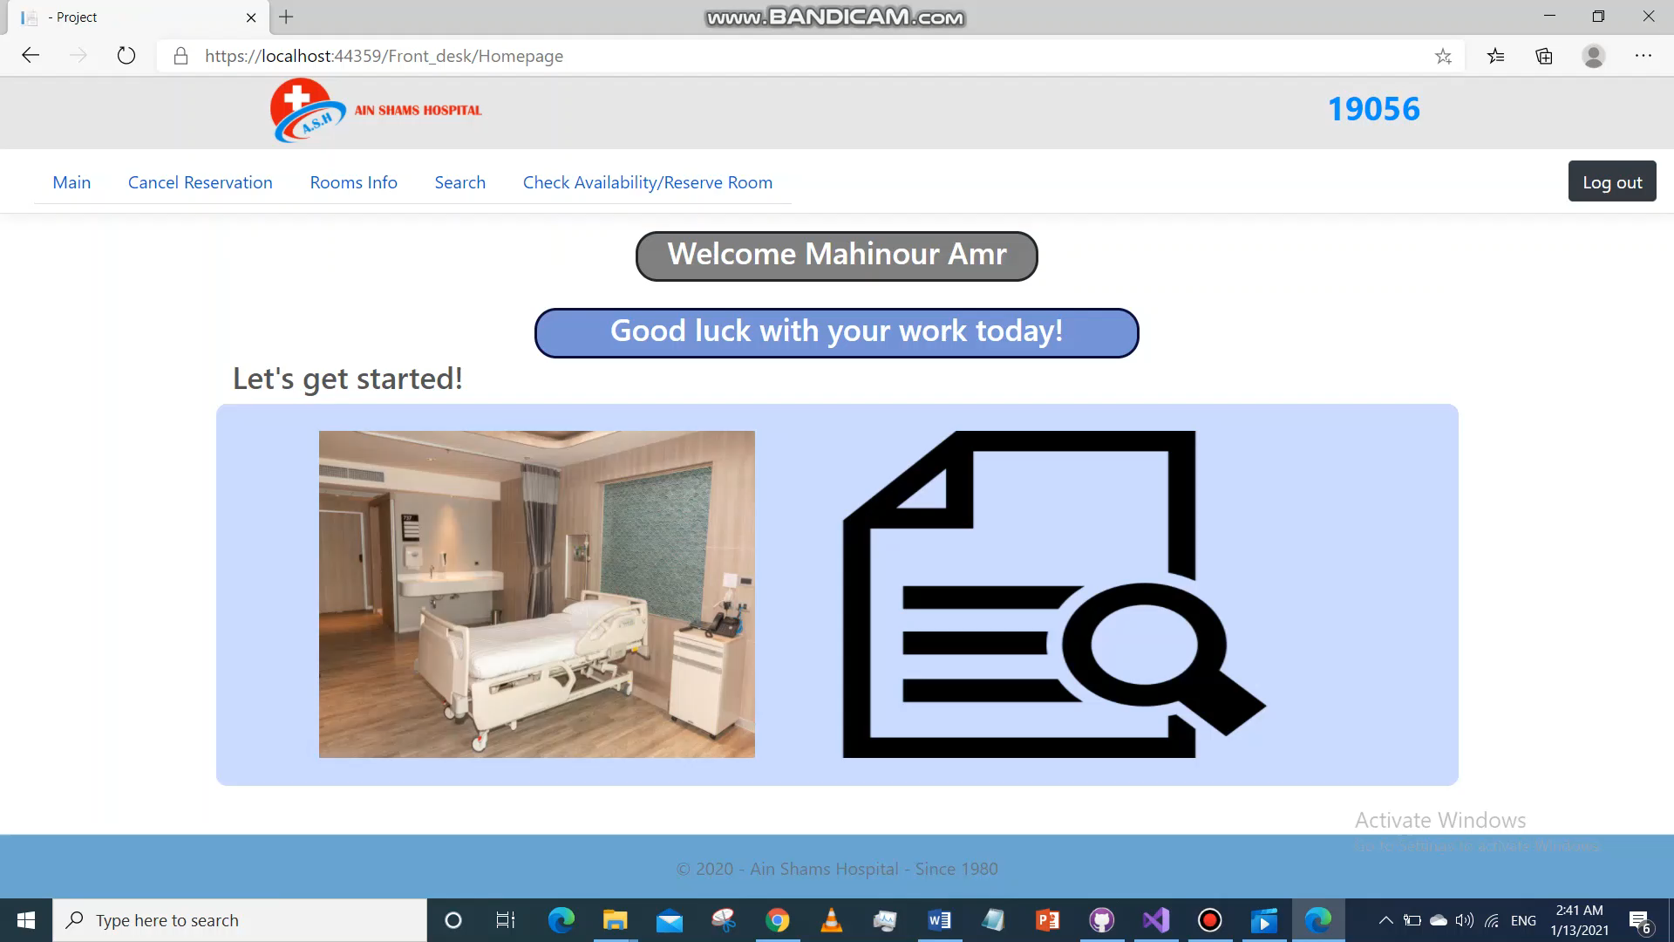
3) Search for Patient
Enter patient’s name and today’s date to know which room he’s in or if he’s not there.

Slide 39
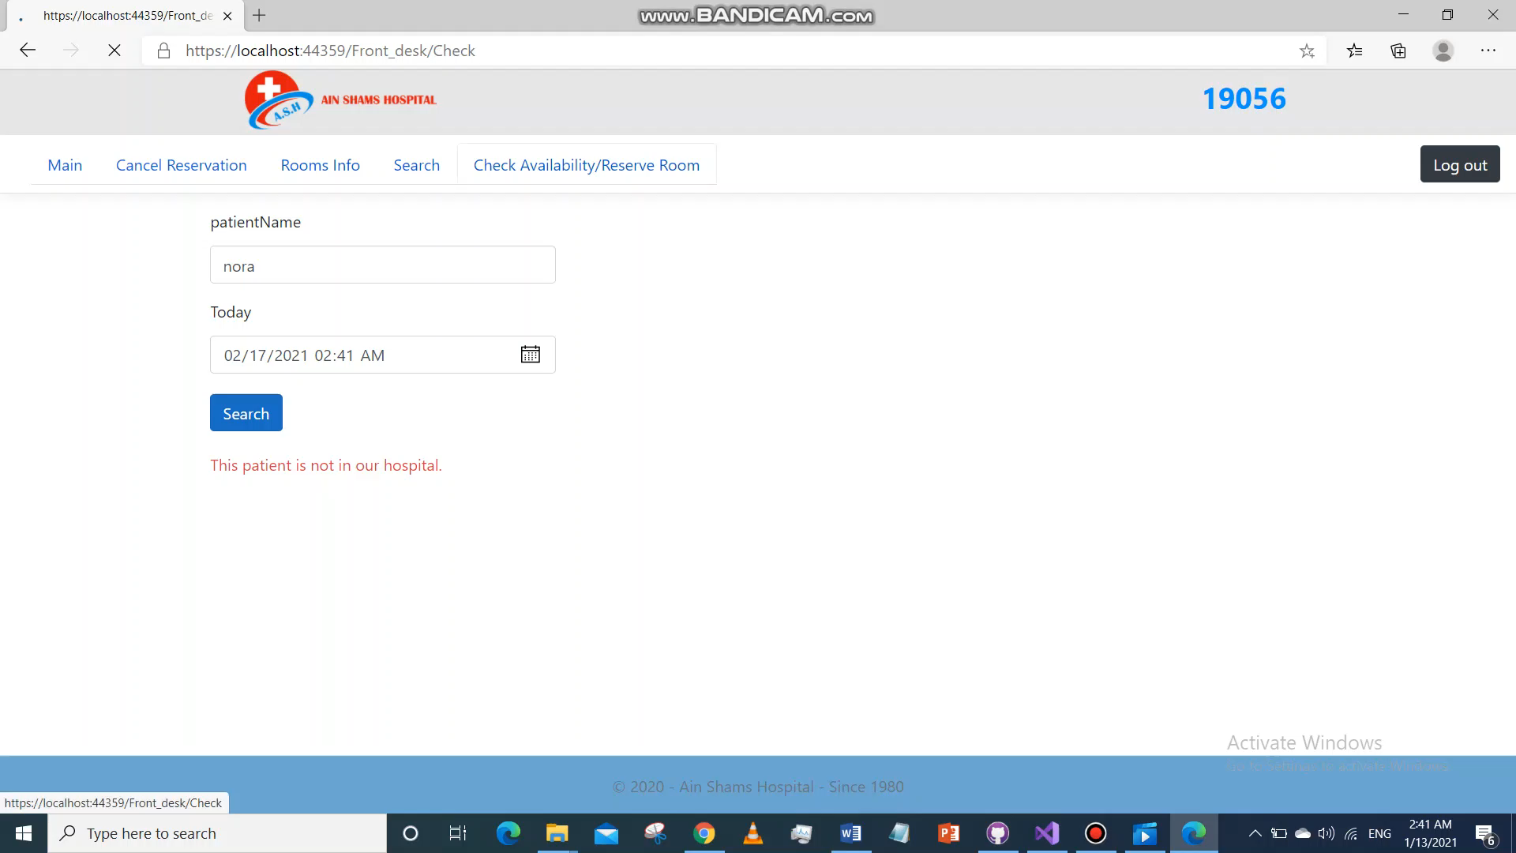
4) Cancel a Reservation
Choose room or surgery and enter patient’s name to cancel his reservation.

Slide 40
5) Transfer Patient to Another Room
Front desk member enters time period he wants to reserve for the other room and view available rooms.
Clicks transfer to enter the patients name he wants to transfer.

Slide 41
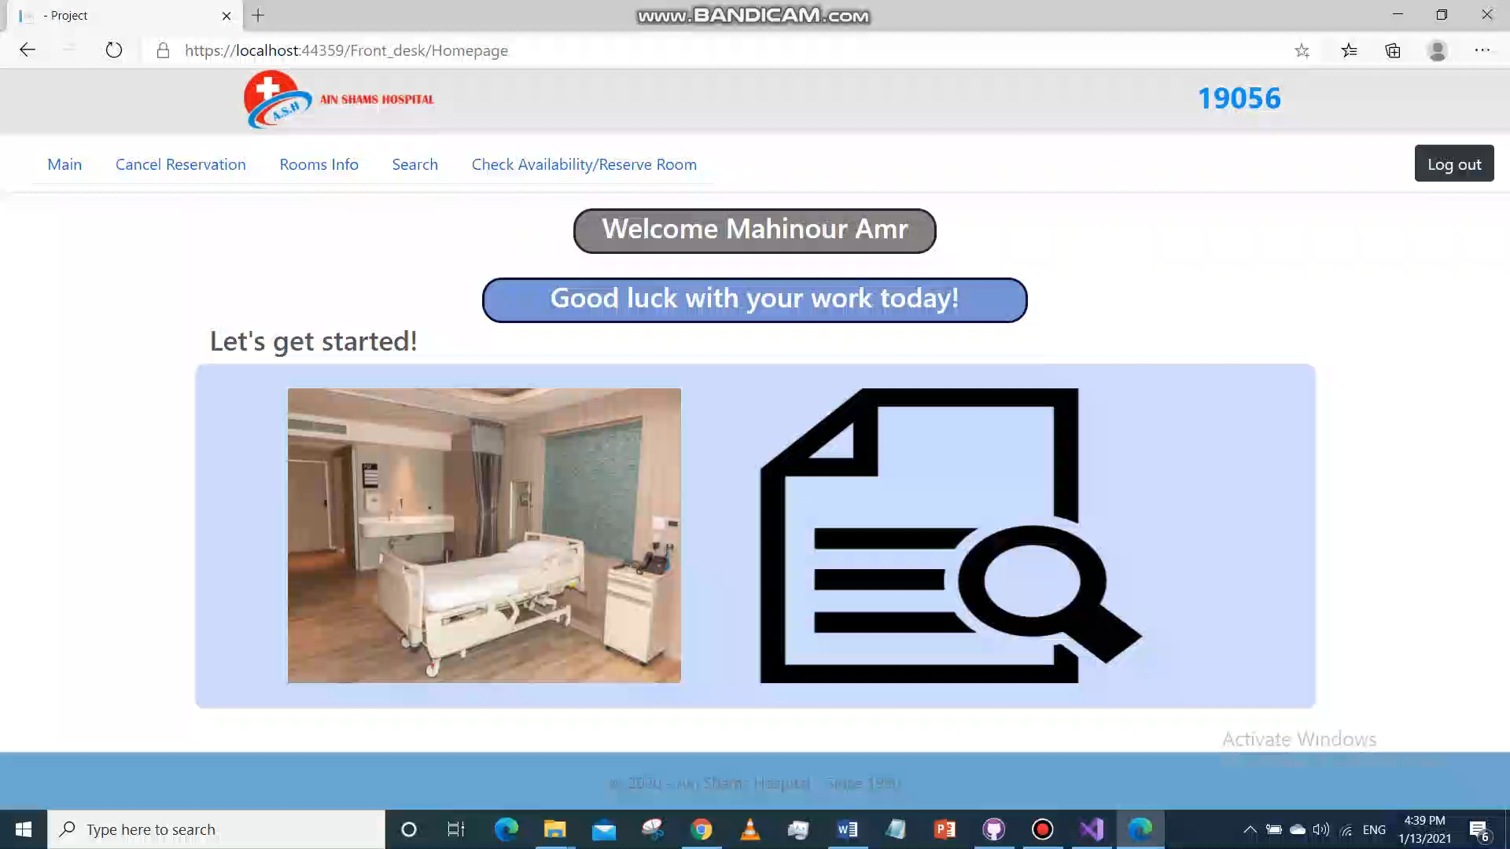

Slide 42

6) Allocate Room
Front desk member can also allocate a room without reserving a surgery room.

Slide 43
Finance

Slide 44
1) Login
The finance member enters the special activation code to open the sign up page of staff.
Enters personal information and signup to open finance home page.

Slide 45
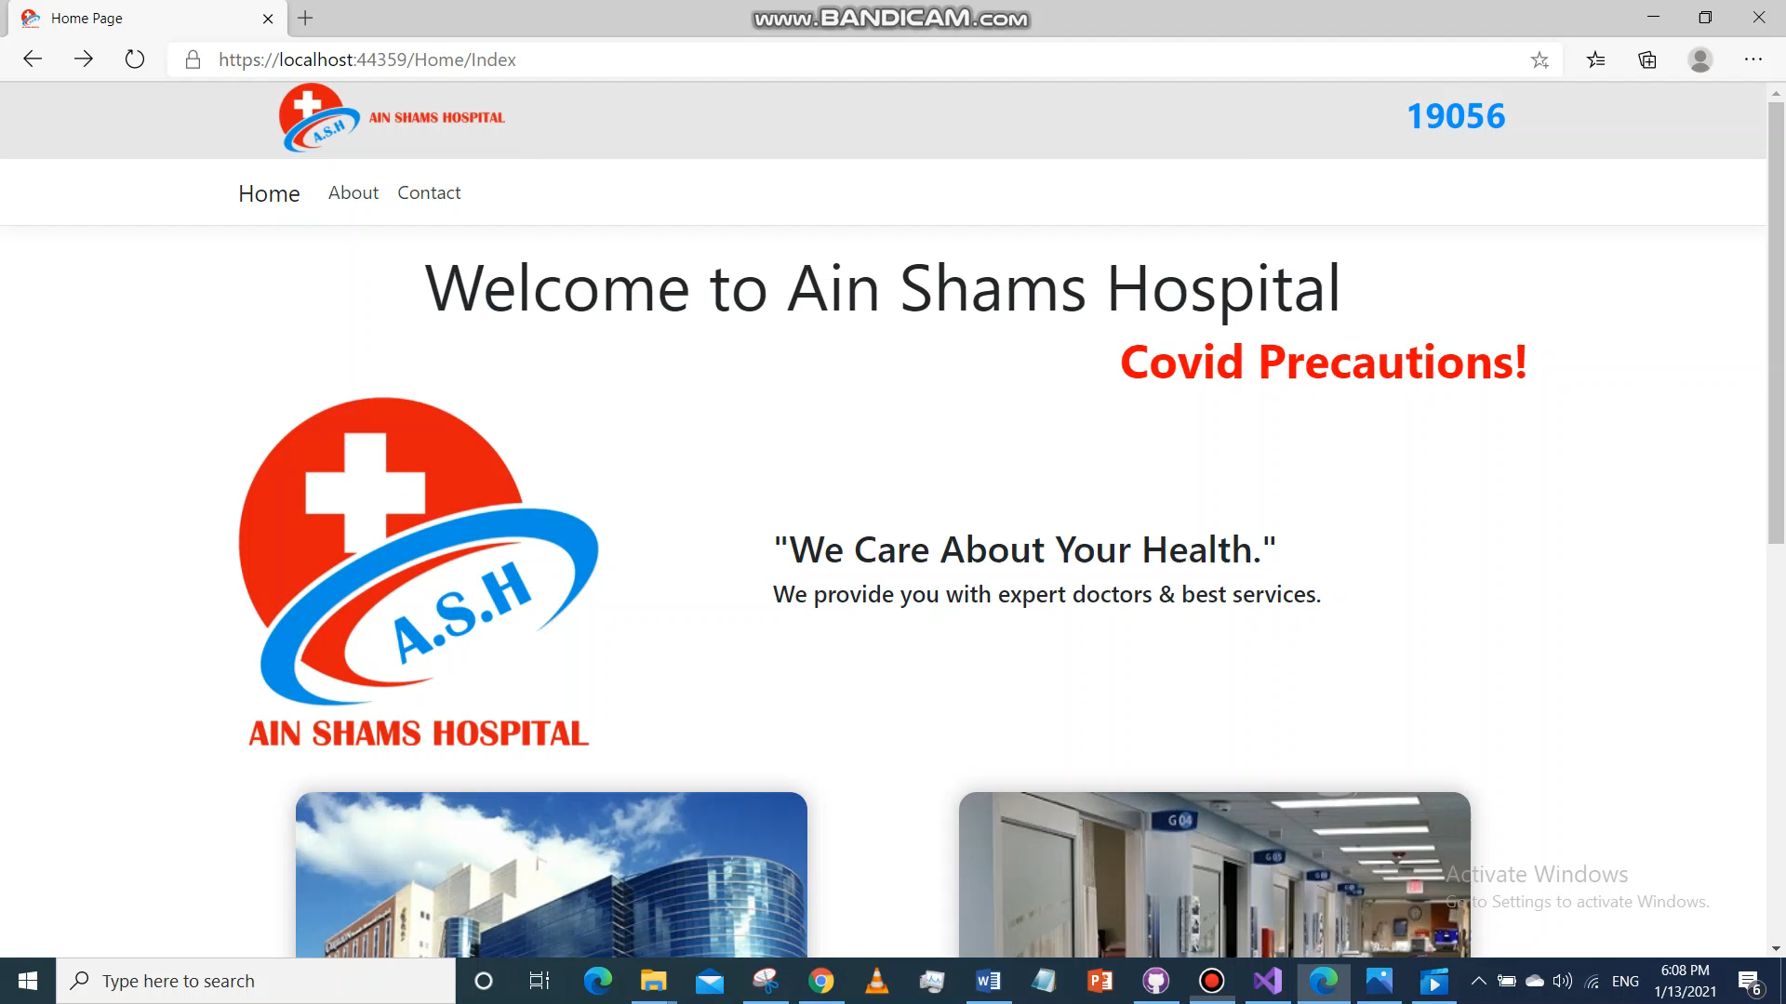

Slide 46
2)View / Update Patient’s Bill
Finance member enters patient’s name and today’s date to show his bill up to this date
Checks the payed item to update patient’s bill.

Slide 47
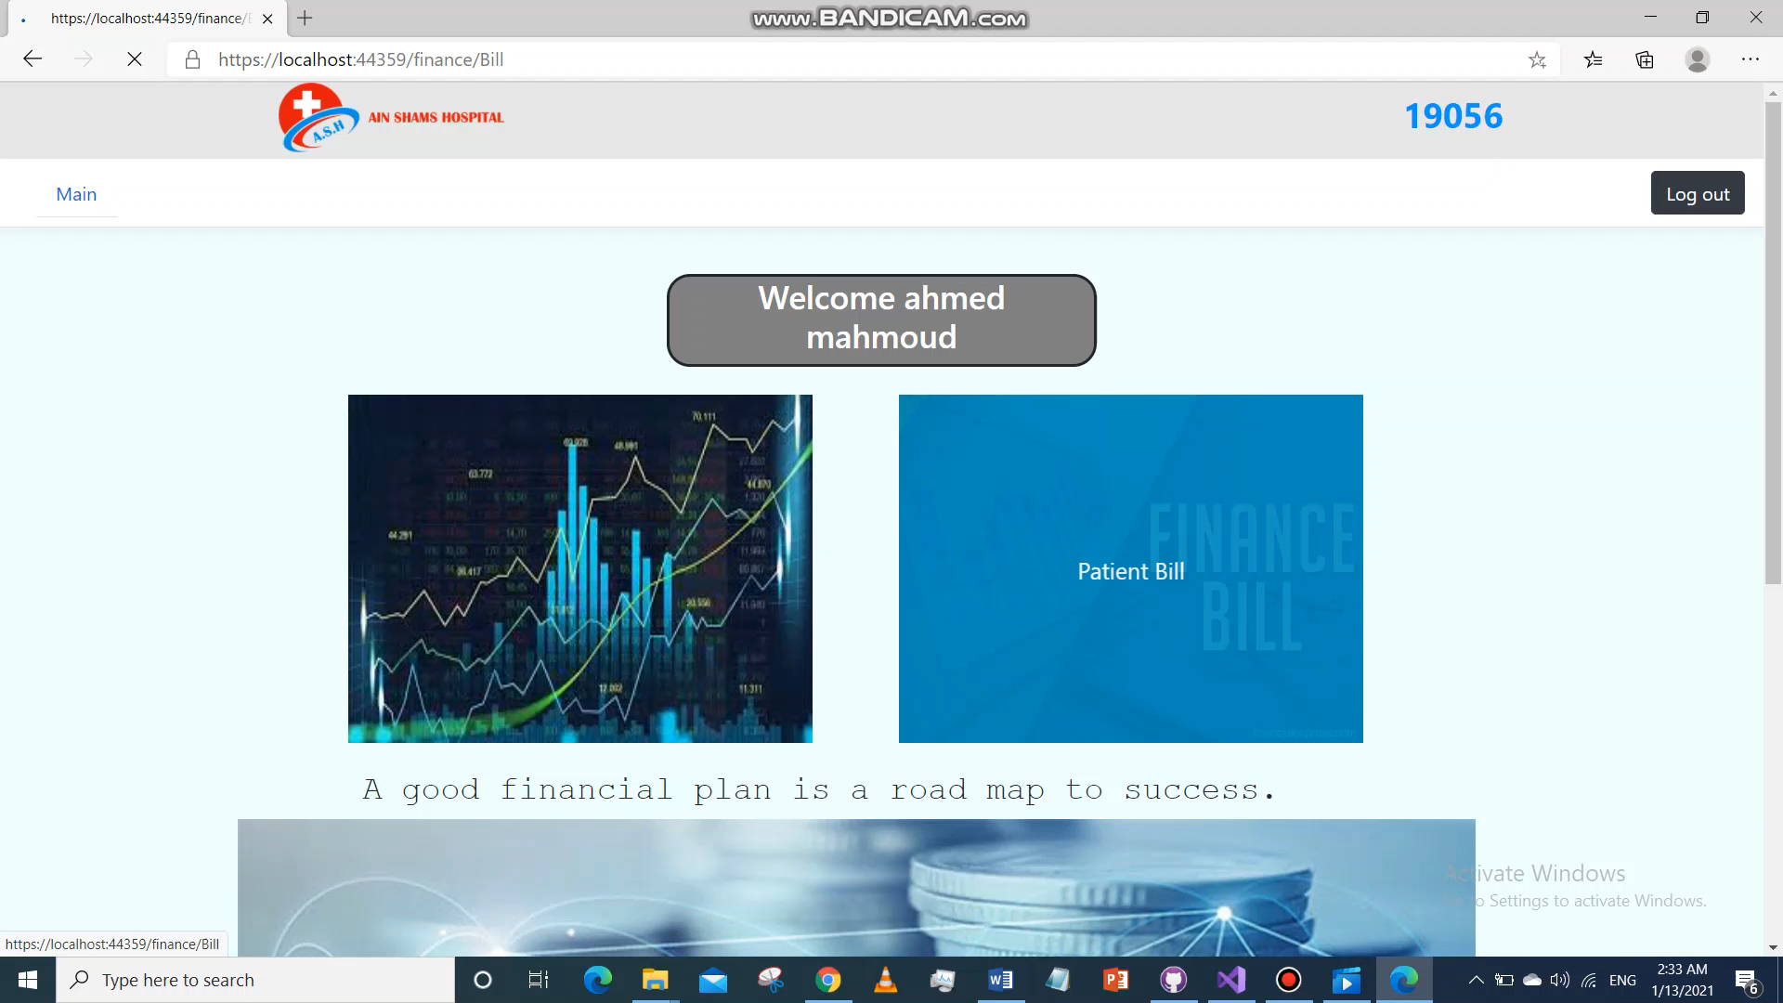

Slide 48
3) View Statistics
Finance member enters the time period he wants to view the statistics of.
He can either choose Total to view total income coming from every type.
Or he can choose a specific type to view it’s statistics only.

Slide 49
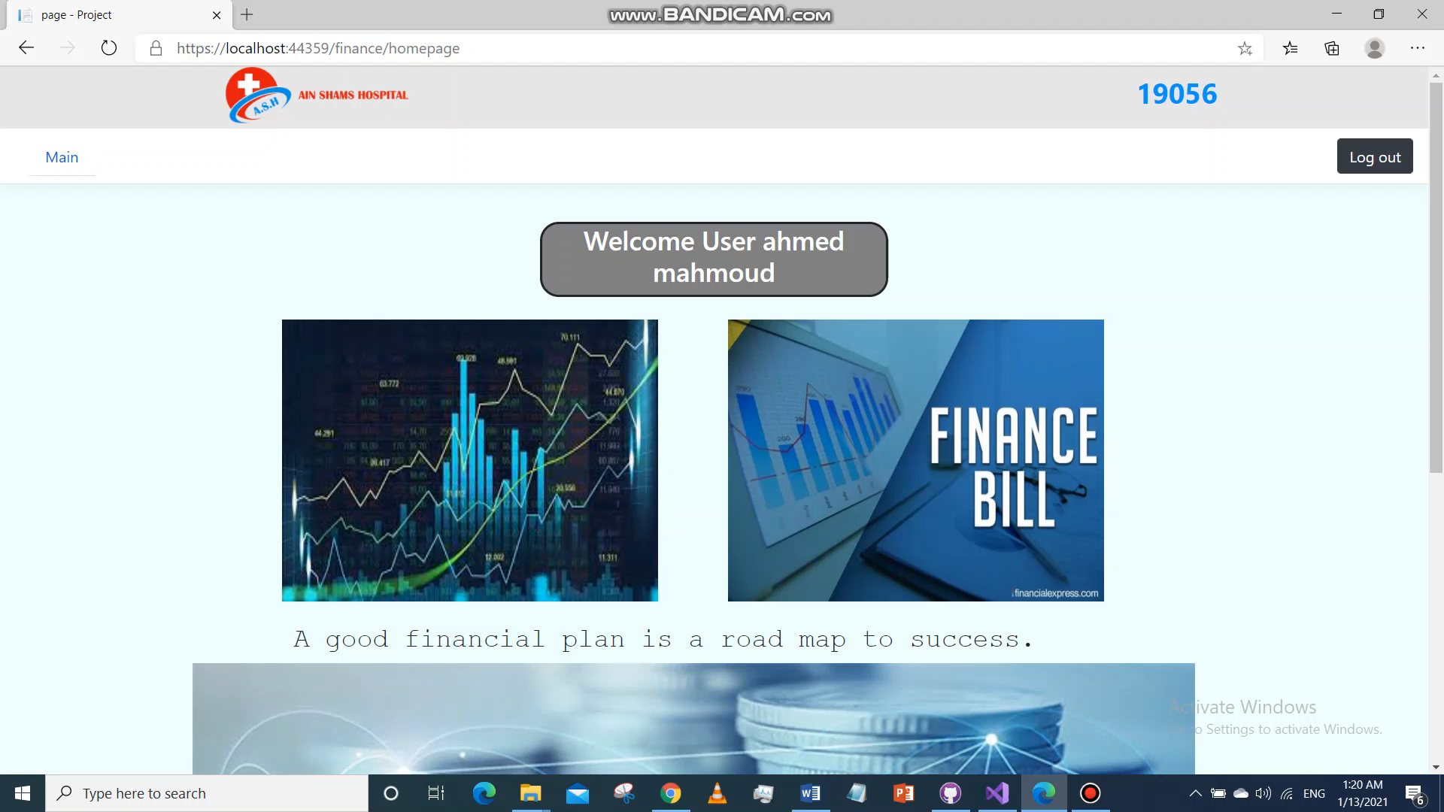

Slide 50
Manager

Slide 51
1) Sign Up
The manager enters the special activation code to open the sign up page of staff.
Enters personal information and signup to open manager home page.

Slide 52


Slide 53
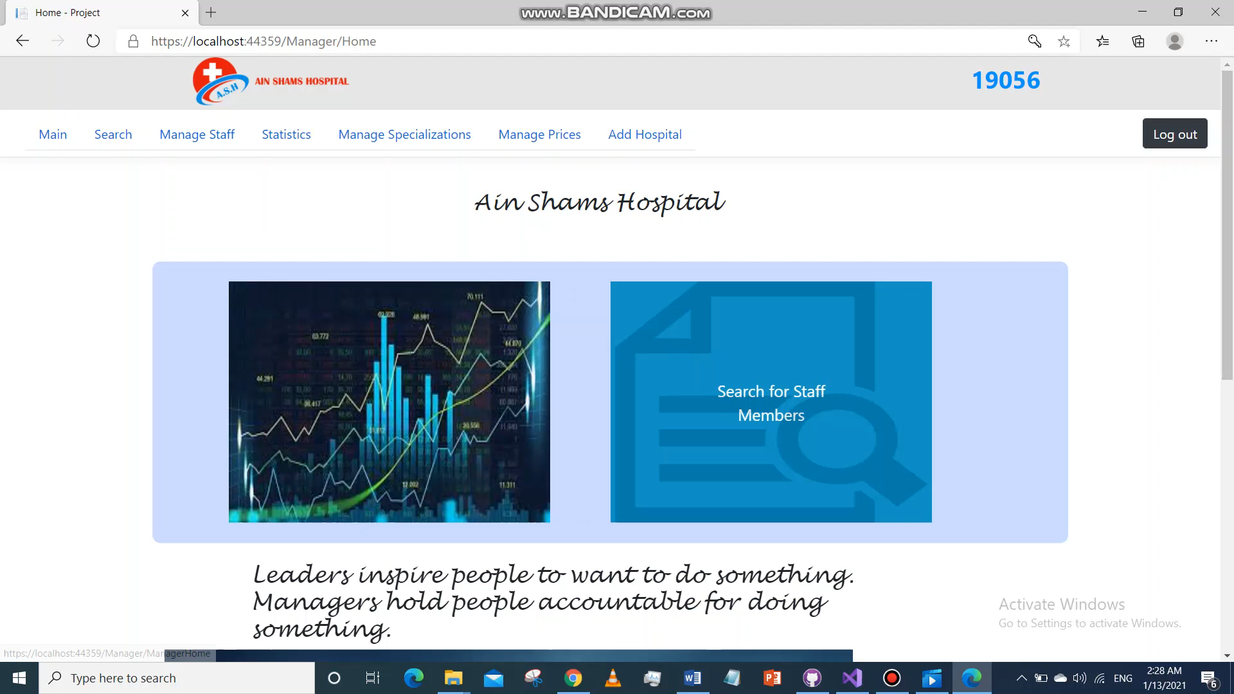
2) Search Staff Member
Manager enters staff member name to view his information.

Slide 54
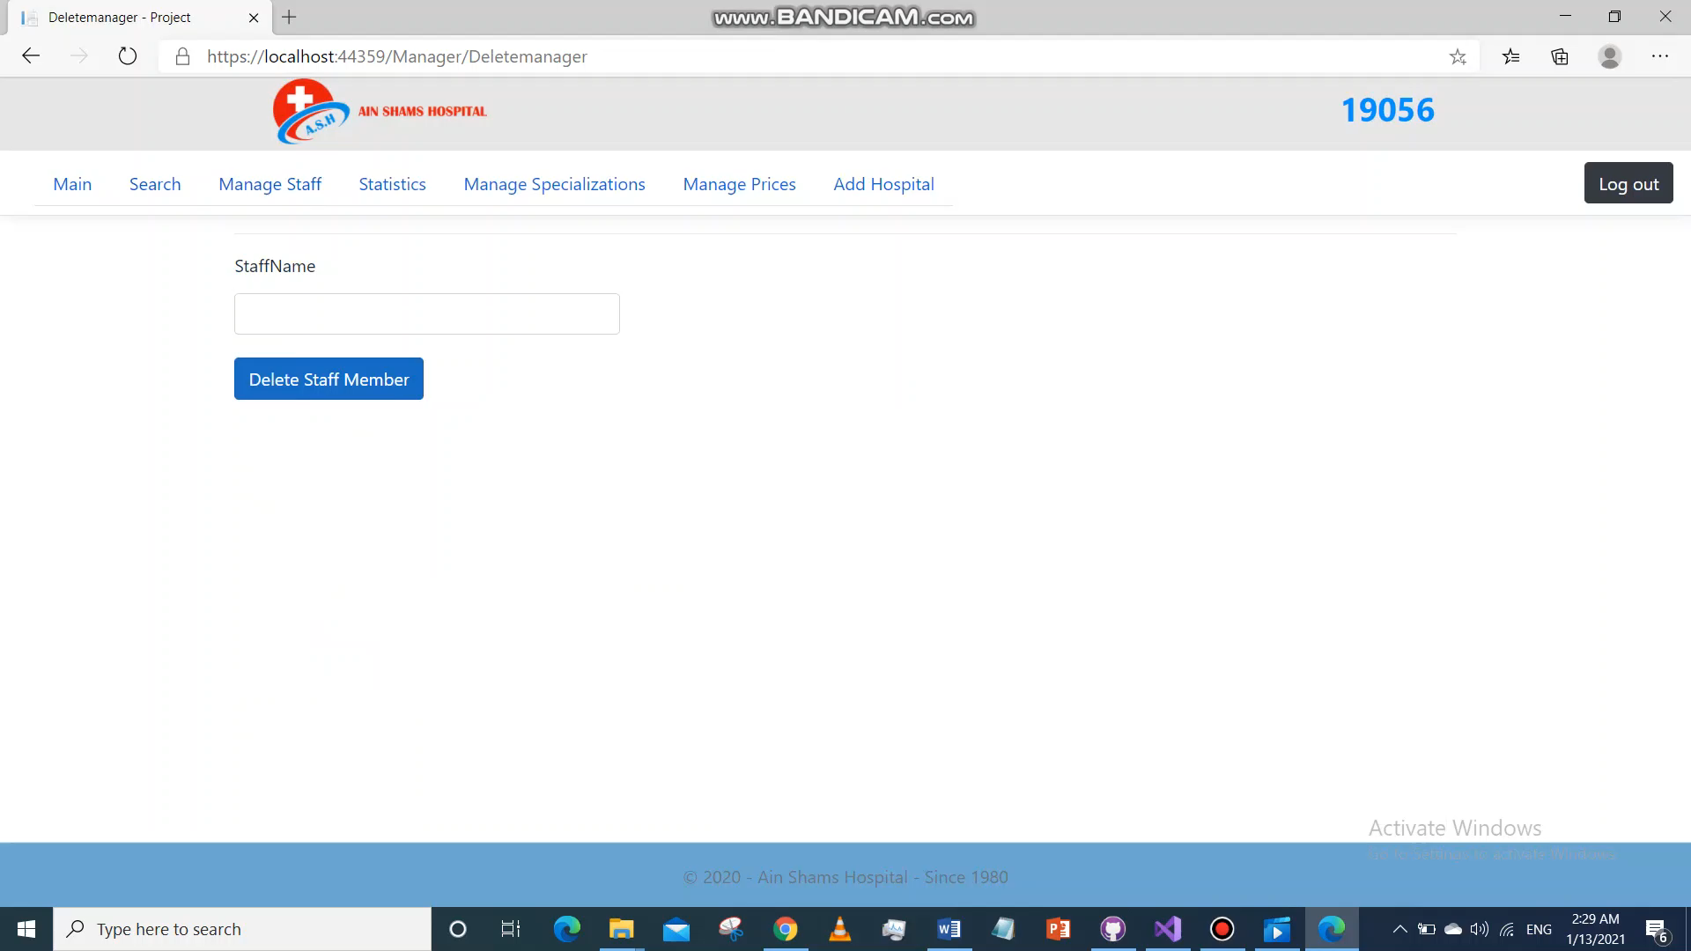
3) Delete Staff Member

Slide 55
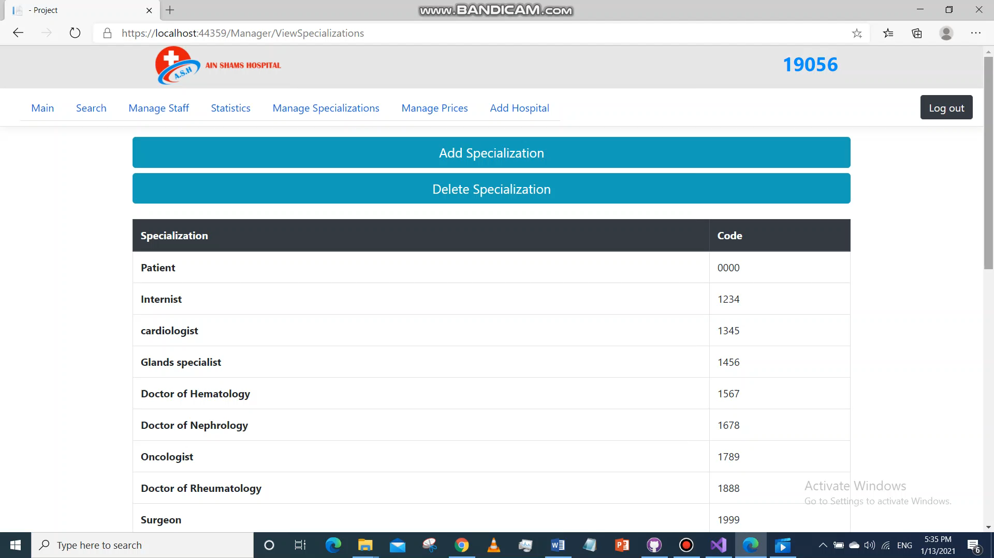
4) Add Specialization
Manager enters specialization name and its code to add it. Couple of errors can happen.

Slide 56
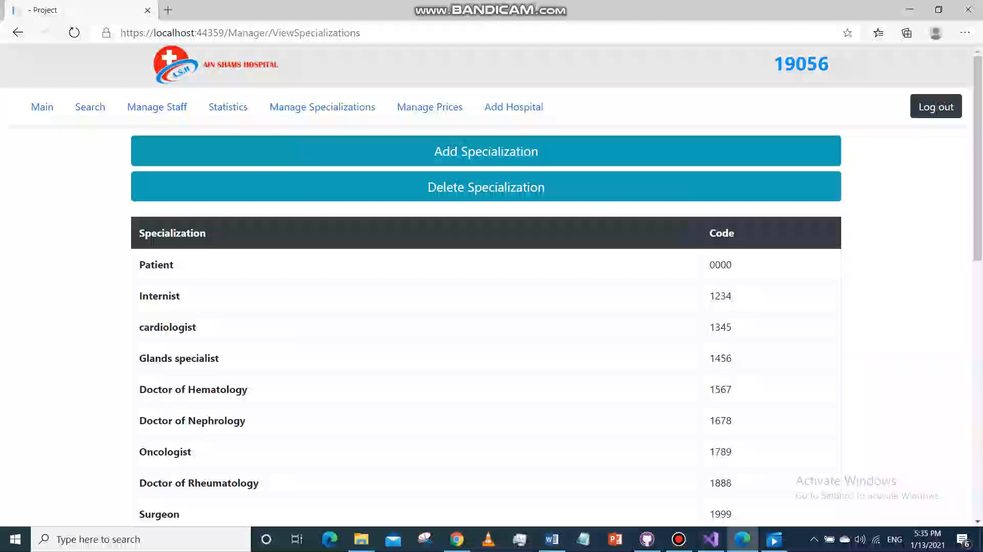
5) Delete Specialization

Slide 57
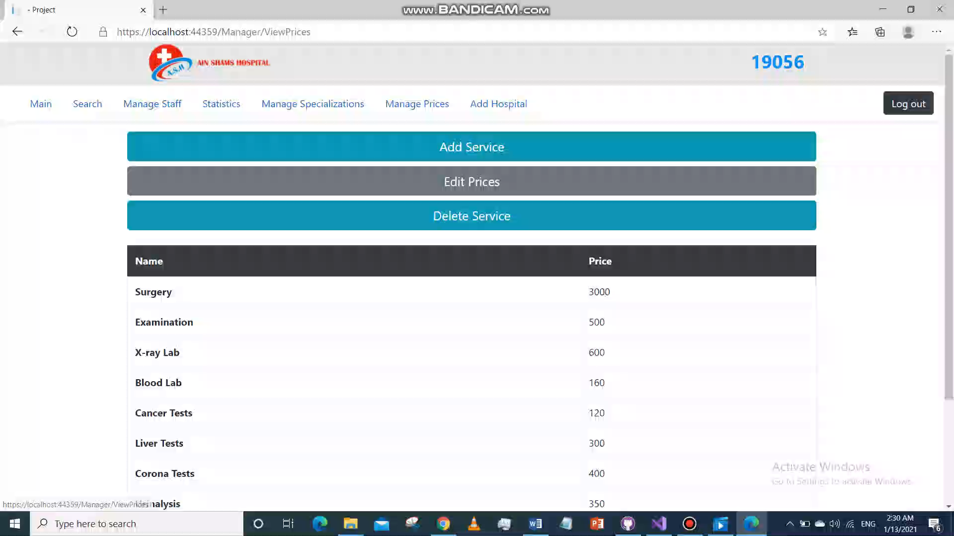
6) Add Service
Manager enters service name and its price to add it.

Slide 58
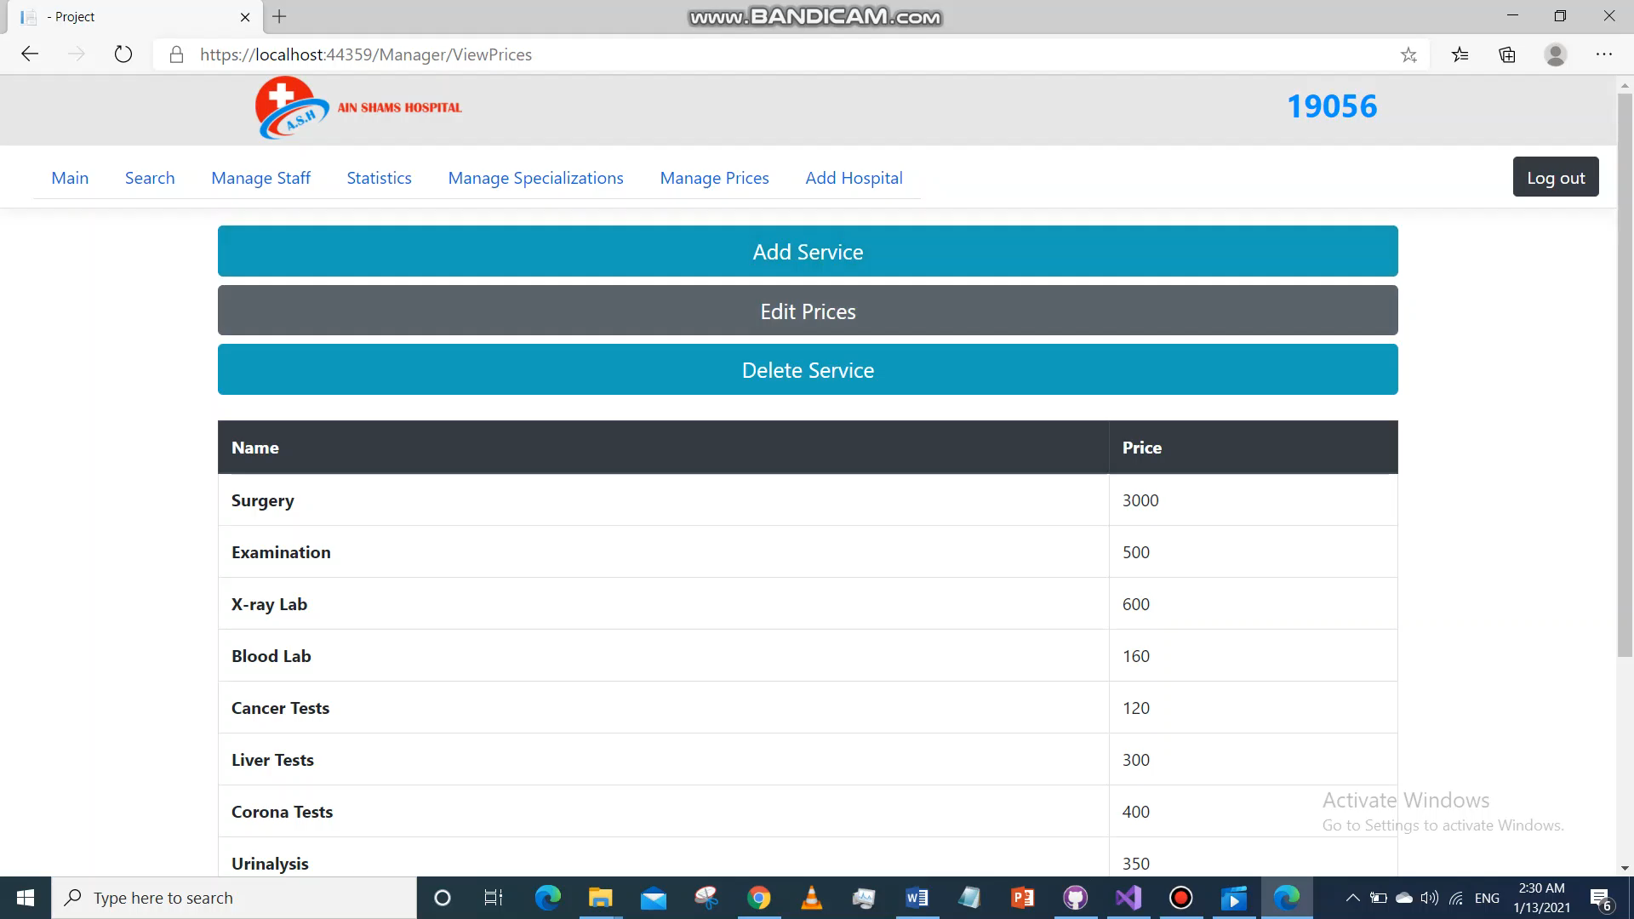
7) Edit Service Price
Manager enters service name and its new price.

Slide 59
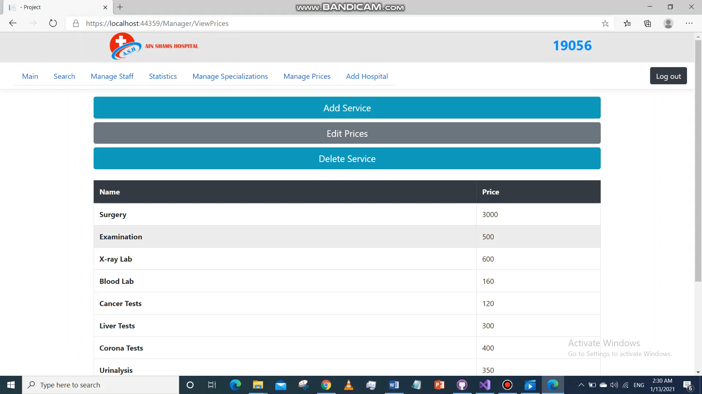
8) Delete Service

Slide 60
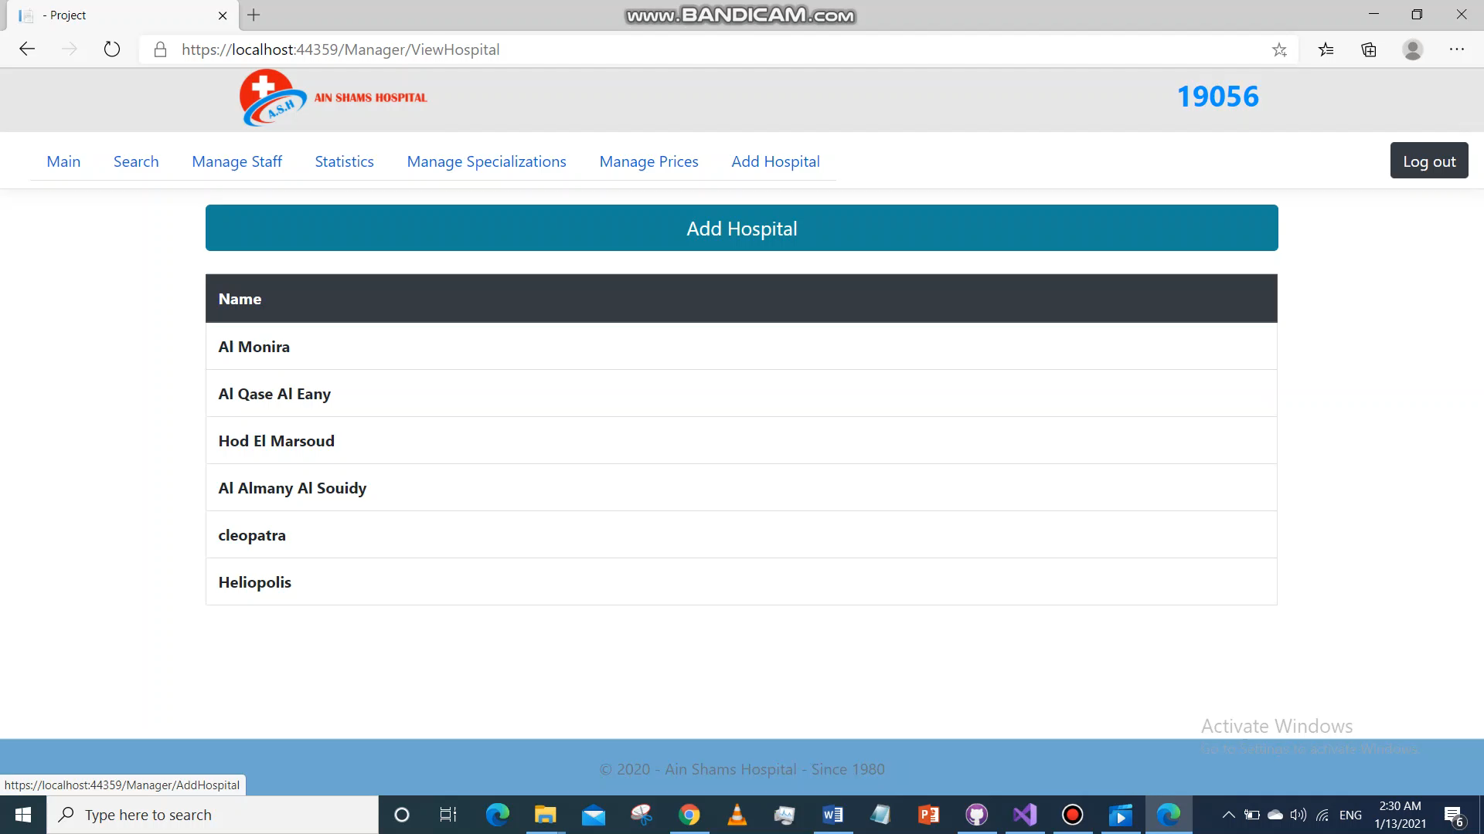
9) Add Hospital

Slide 61
10) View Statistics
Manager enters the time period he wants to view the statistics of.
He can either choose Total to view total income coming from every type.
Or he can choose a specific type to view it’s statistics only.

Slide 62
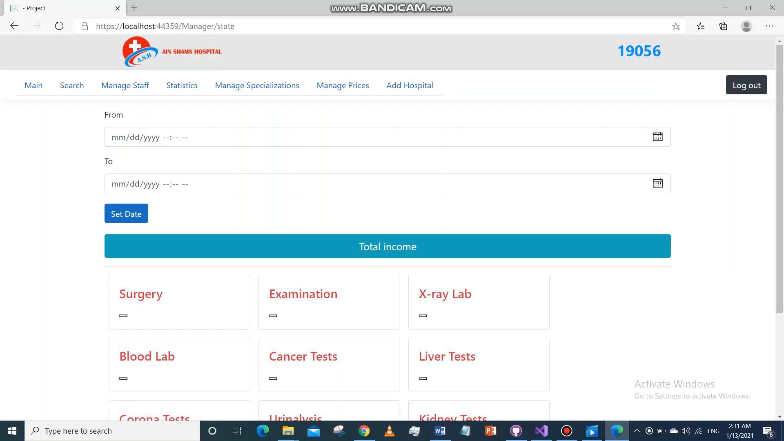

Slide 63
Thank You ☺

